Slide 1

Unsupervised Anomaly Detection on X-Ray Images
Pranav Lodha
Subarna Chowdhury Soma
Jeyasri Subramanian

Slide 2
Problem Statement
Detect Anomalies in X-ray images using Generative Adversarial Networks.
GANs are mainly used to generate large volume of synthetic data.
We have utilized GAN’s discriminator and generated synthetic images to detect anomaly in X-ray images

Slide 3

Dataset (MURA-v1.1)
MURA is one of the largest public radiographic image datasets.
MURA (musculoskeletal radiographs) is a large dataset of bone X-rays.
Total Size: 3.45gb

Slide 4
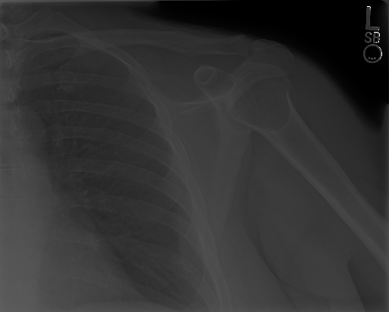
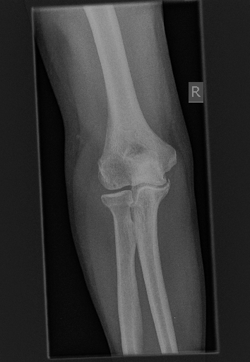
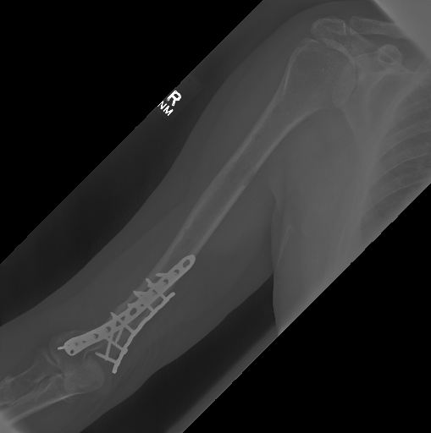
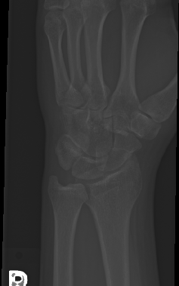
Dataset Samples
Elbow
Positive (2006)
Negative (2925)
Finger
Positive (1968)
Negative (3138)
Forearm
Positive (661)
Negative (1164)
Hand
Positive (1484)
Negative (4059)
Humerus
Positive (599)
Negative (673)
Shoulder
Positive (4168)
Negative (4211)
Wrist
Positive (3987)
Negative (5765)
Notes:
Positive – Image contains anomaly
Negative - Image is completely normal

Slide 5
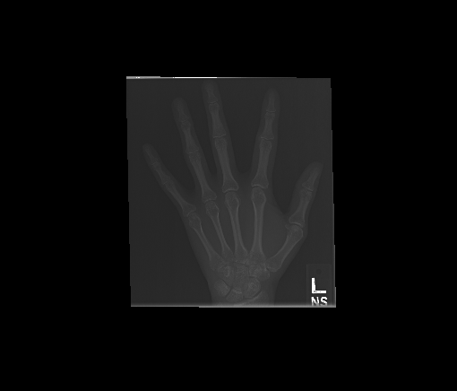
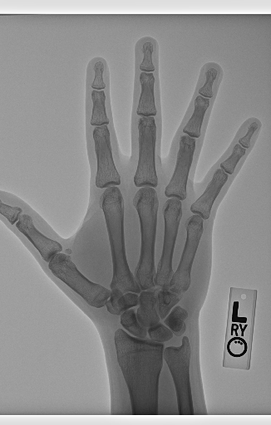
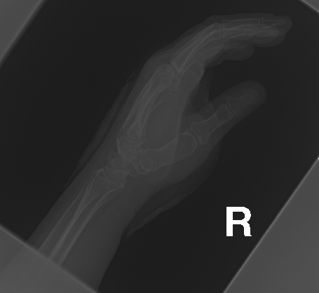
Preprocessing
Crop Image: Using OpenCV, we cropped the image based on where contours were visible
Resize Image: Reduce the size of image to a size that is much more manageable
Augmentation
Flipping
Rotating
Zoom in/out
Notes:
-- Add the other 3 even if they are rotations

Slide 6
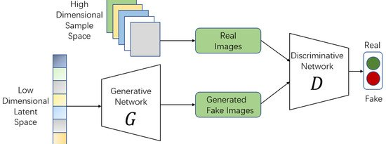
Alpha GAN
Loss: Binary cross entropy between fake/reconstructed images
Outlier Score: Mean Square Error

Slide 7
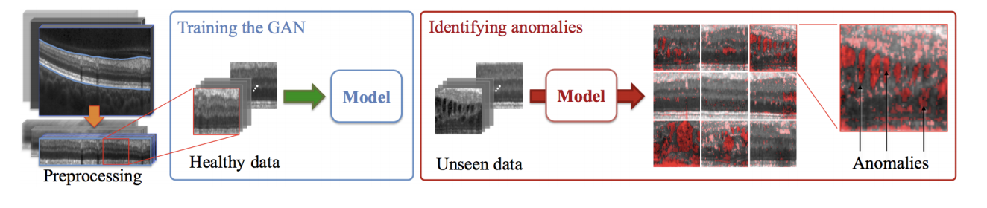
F-AnoGAN
Loss: Adversarial loss
Formula for loss = mean(fake_data) - mean(real_data) + lambda_gp * gradient_penalty

Slide 8
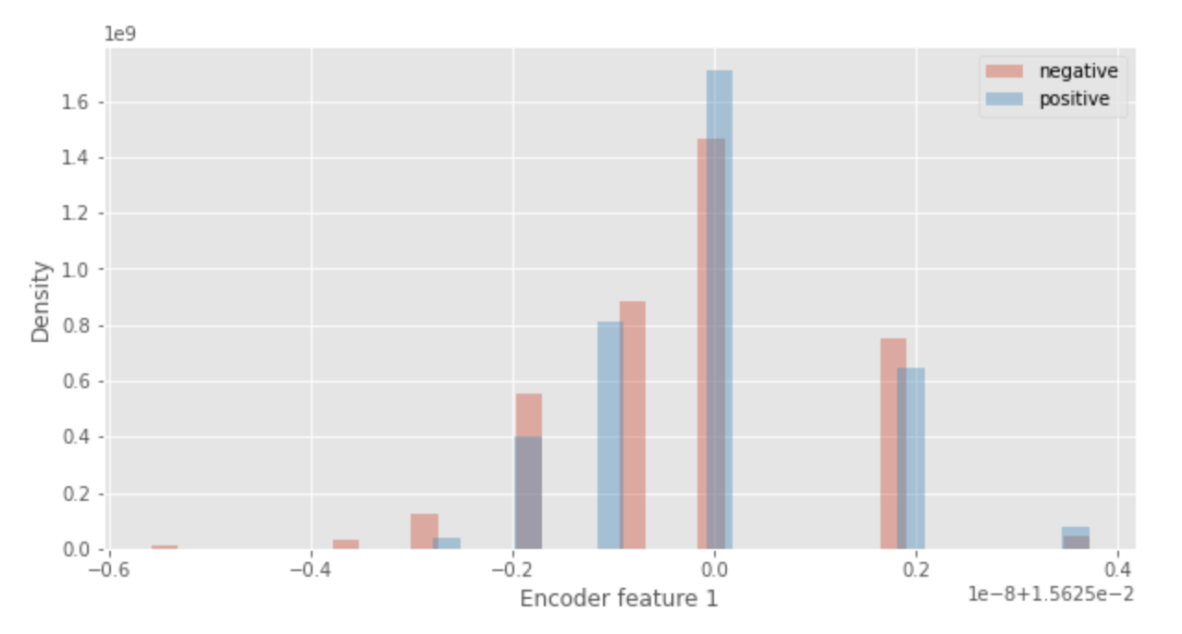
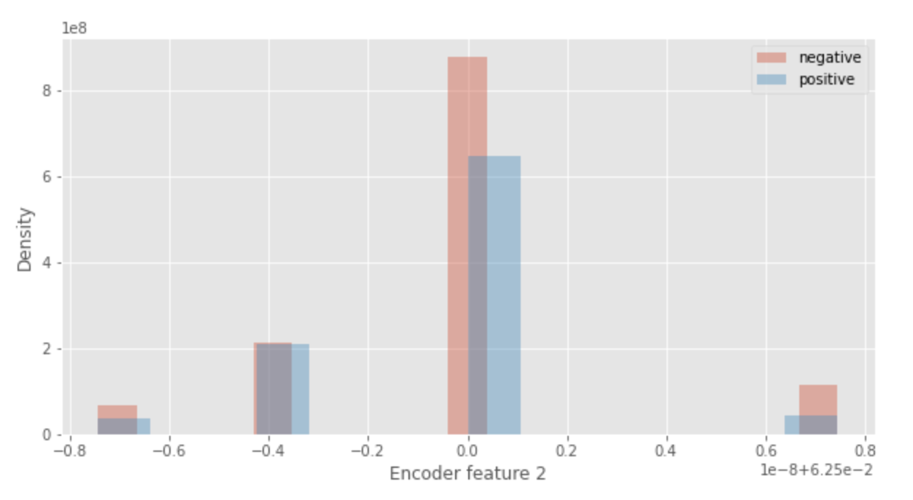
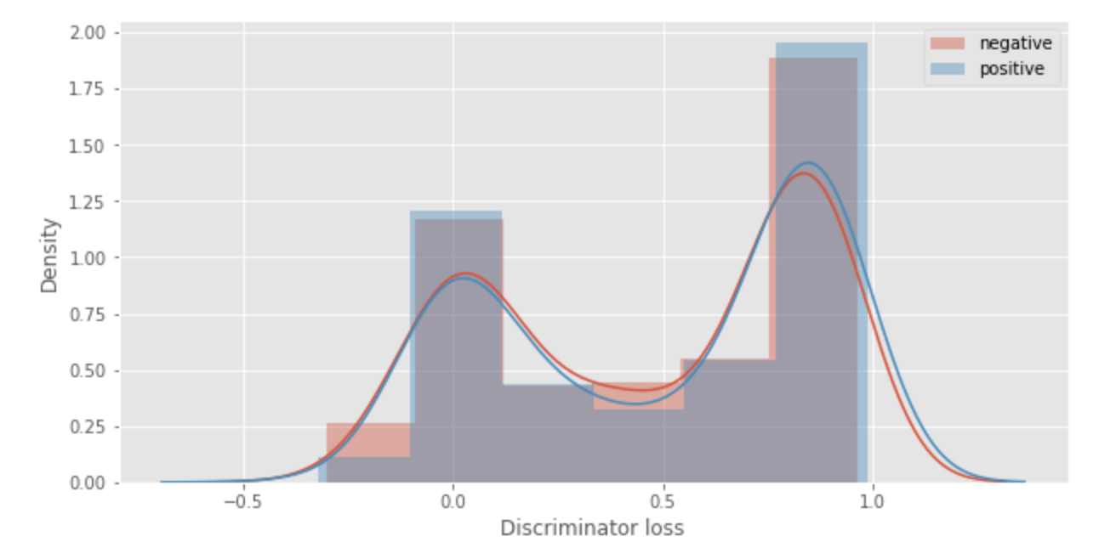
Loss Definitions
Reconstruction Loss: Differences between the original and reconstructed images
Feature Matching Loss: Differences between the encoded features of hidden layers in the encoder and discriminator
Discriminator Loss: Output of the discriminator

Slide 9
Inference - Architecture
Compute image distance
Fake Image
Input Data
Generator
1. Image Distance
Discriminator
Compute Feature Difference
Detect Anomaly
Discriminator
2. Feature Distance: mse_loss
Notes:
Feature distance is computed from discriminator output
Image distance is computed from real and fake images
Compute absolute difference between real and fake images

Slide 10
Inference pipeline
Generate Fake images using trained generator model
Get discriminator values for real and fake images
Compute feature distance from the discriminator outputs.
Compute image distance from the real and fake images
Compute Anomaly score from the distances
Notes:
Explain Generator and Discriminator training process

Slide 11
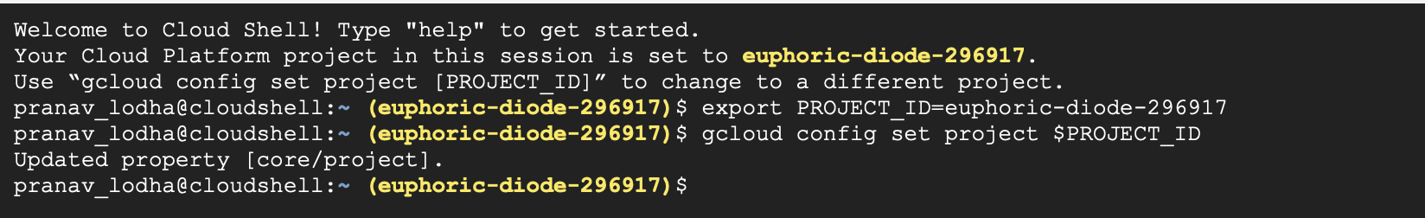
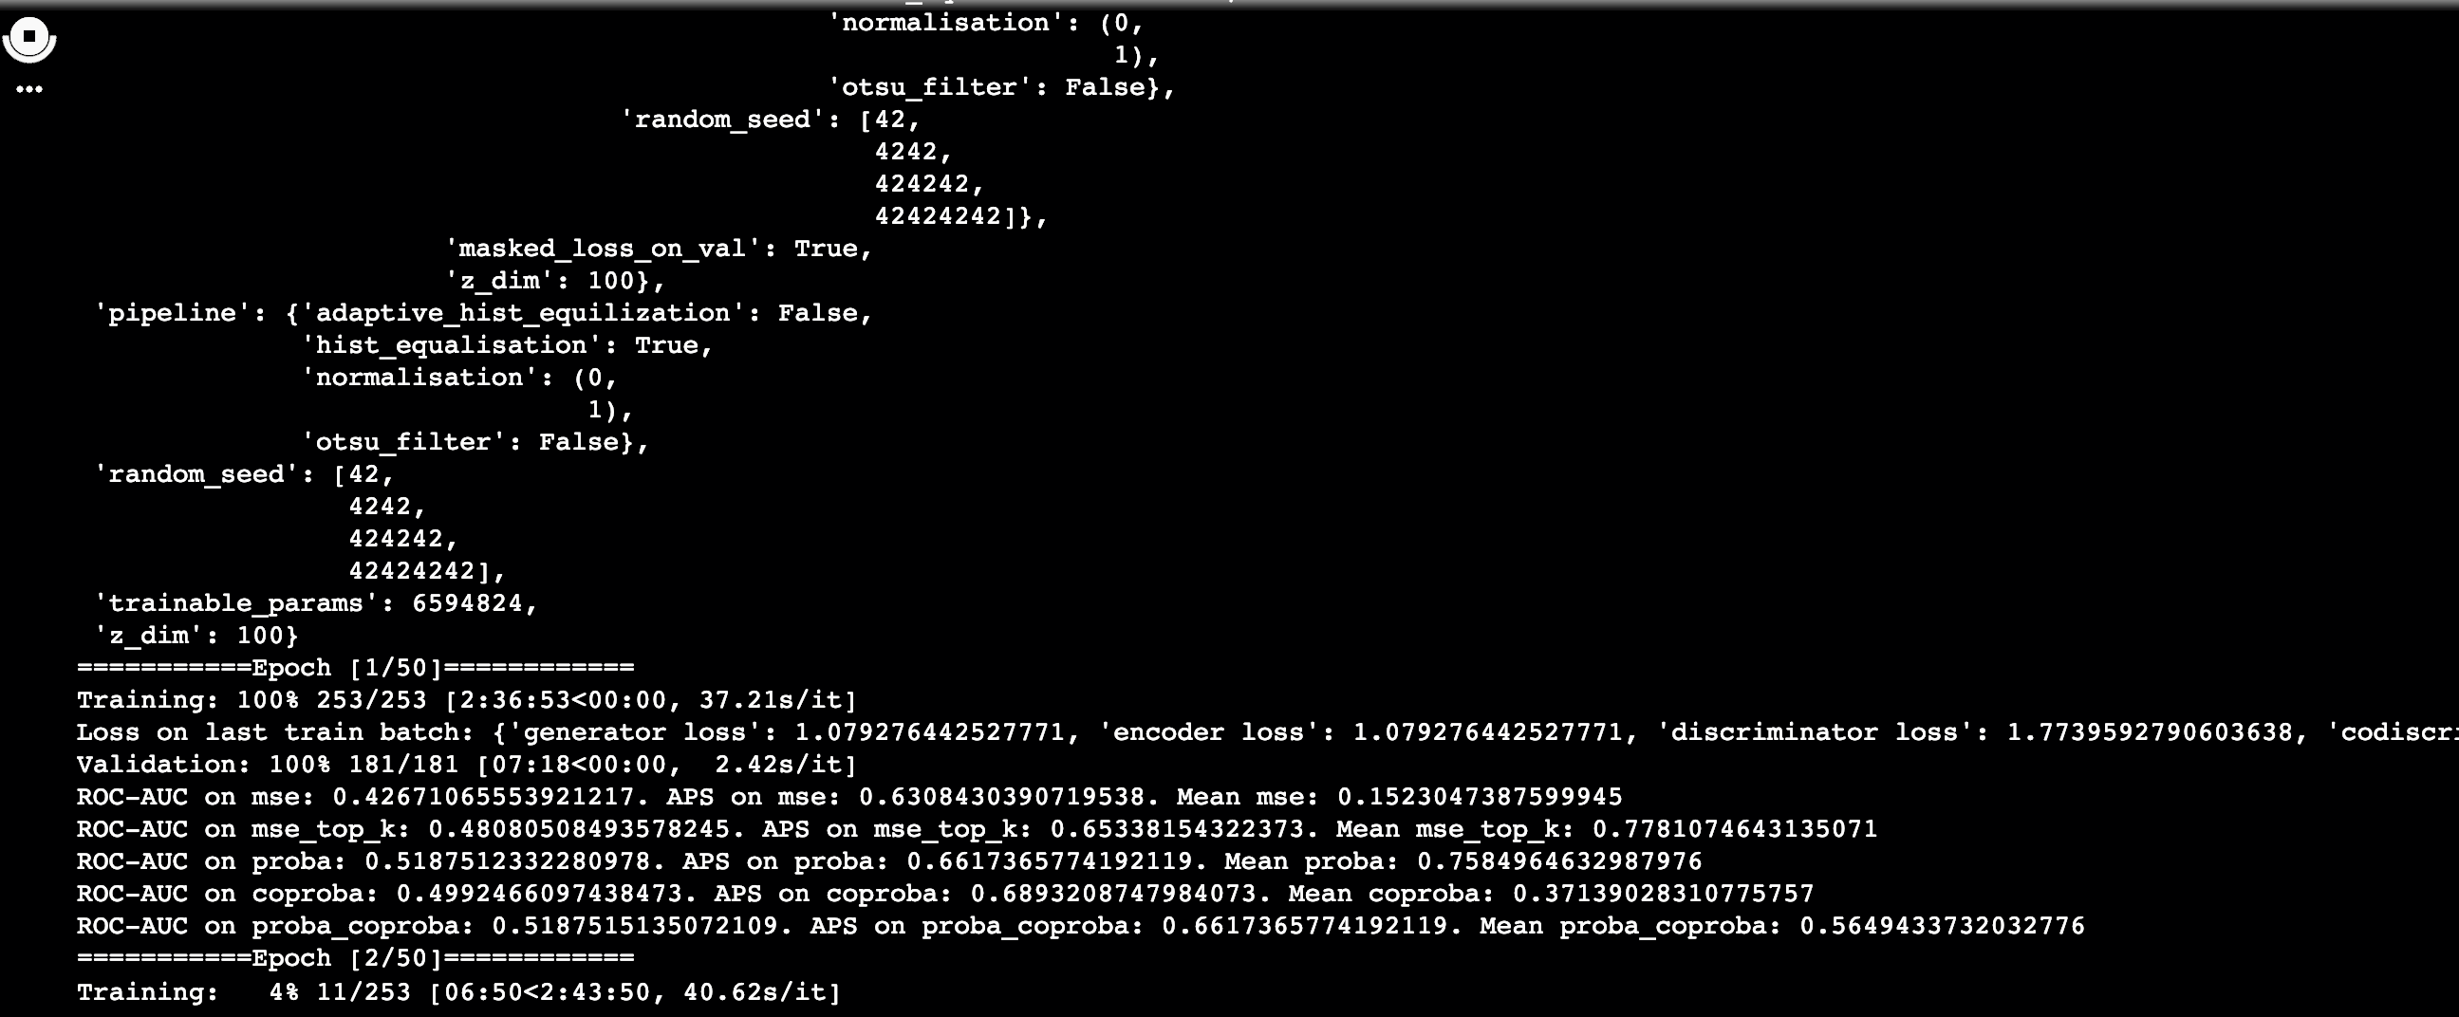
Google Cloud Platform TPU

Slide 12
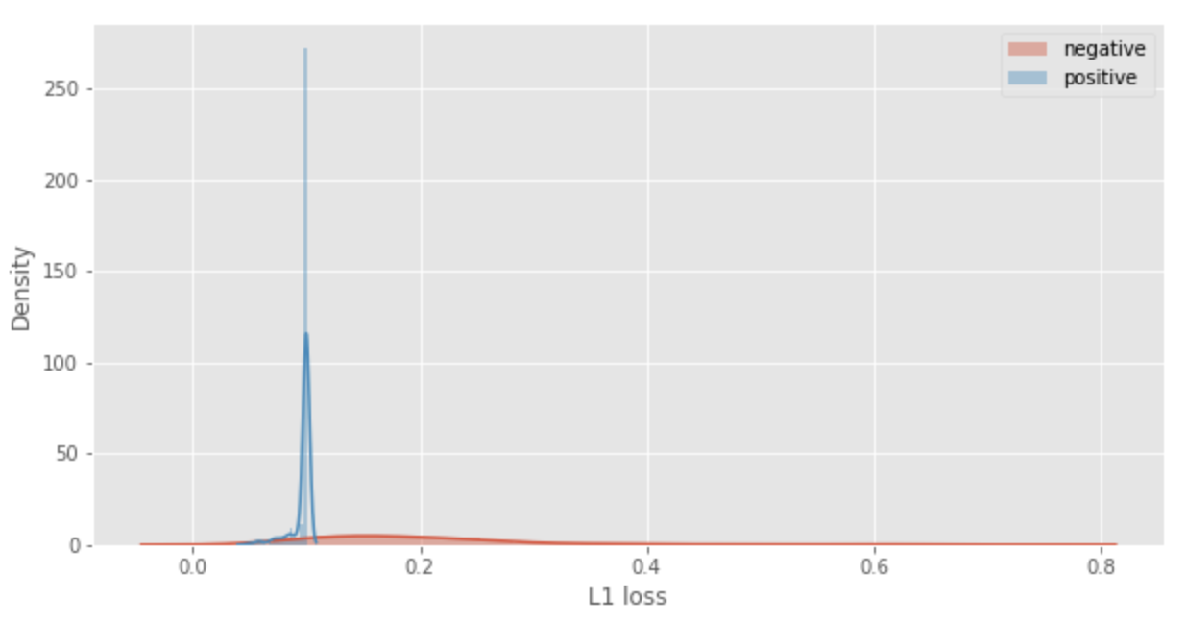
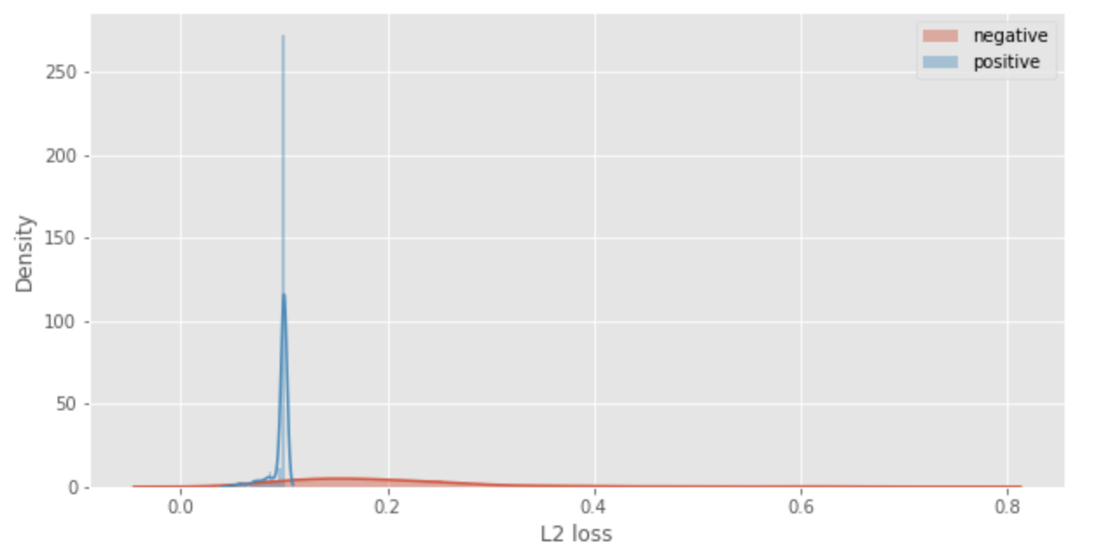
Metrics visualization for AlphaGAN

Slide 13
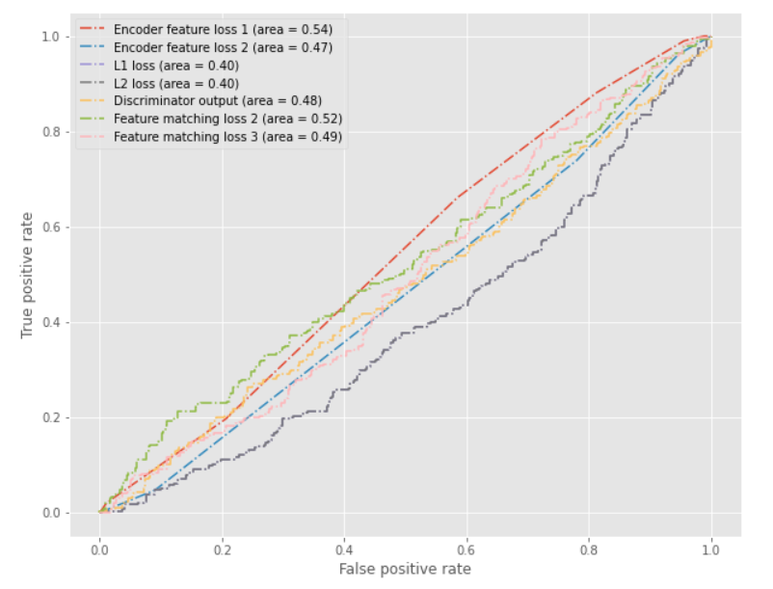
True Positive Rate vs. False Positive Rate

Slide 14
AnoGAN Metrics
No. | Category | ROC- AUC
1 | ELBOW | 0.88
2 | FINGER | 0.92
3 | FOREARM | 0.93
4 | HAND | 0.78
5 | HUMERUS | 0.91
6 | SHOULDER | 0.89
7 | WRIST | 0.97

Slide 15
Comparison: f-AnoGAN vs. AlphaGAN
No. | Category | F-AnoGAN | AlphaGAN
1 | ELBOW | 0.88 | 0.62
2 | FINGER | 0.92 | 0.65
3 | FOREARM | 0.93 | 0.69
4 | HAND | 0.78 | 0.58
5 | HUMERUS | 0.91 | 0.60
6 | SHOULDER | 0.89 | 0.65
7 | WRIST | 0.97 | 0.74

Slide 16
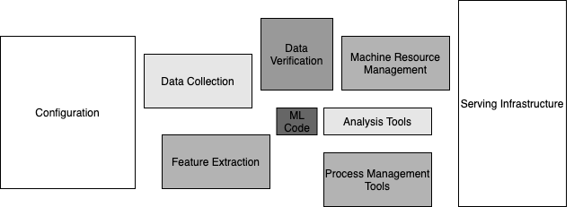
Integration Pipeline

Slide 17
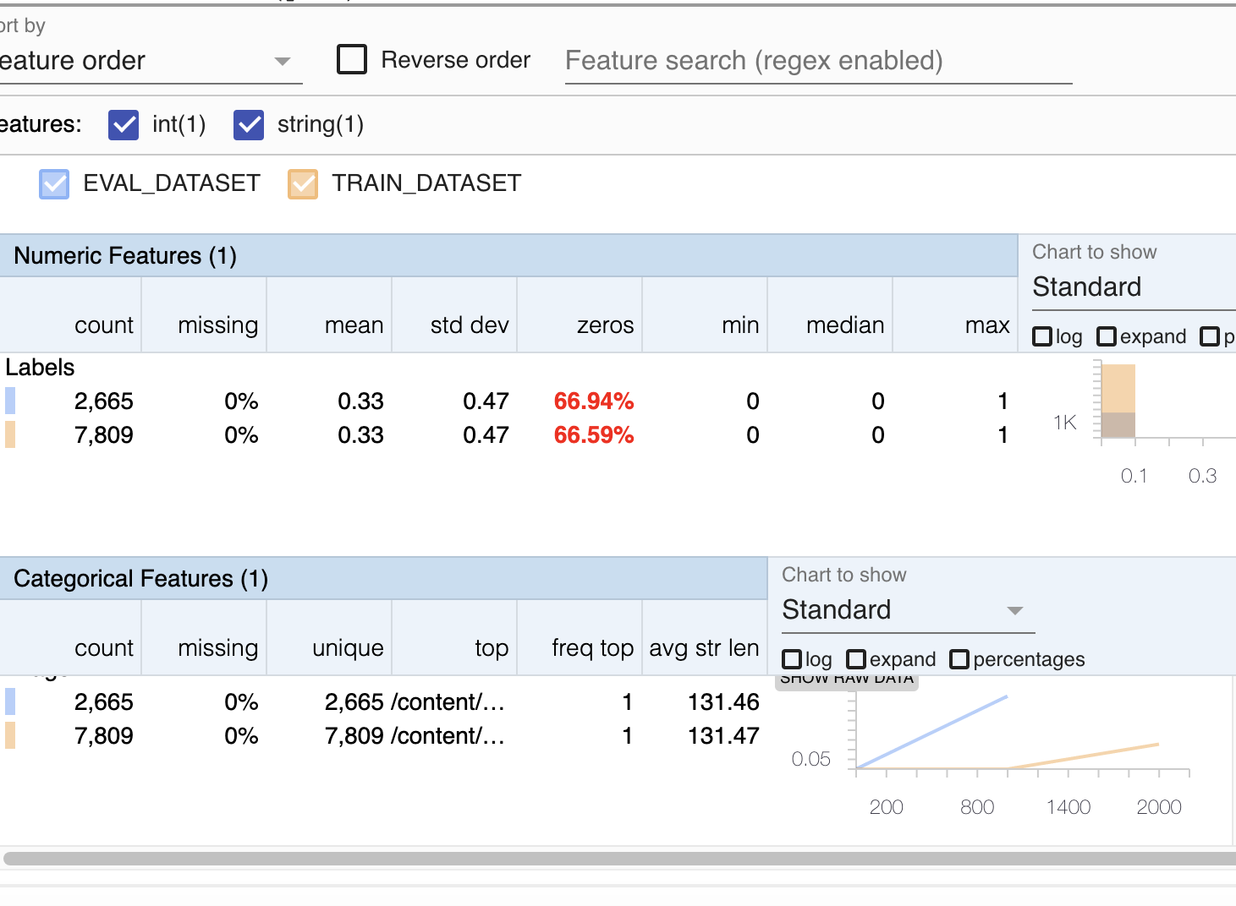
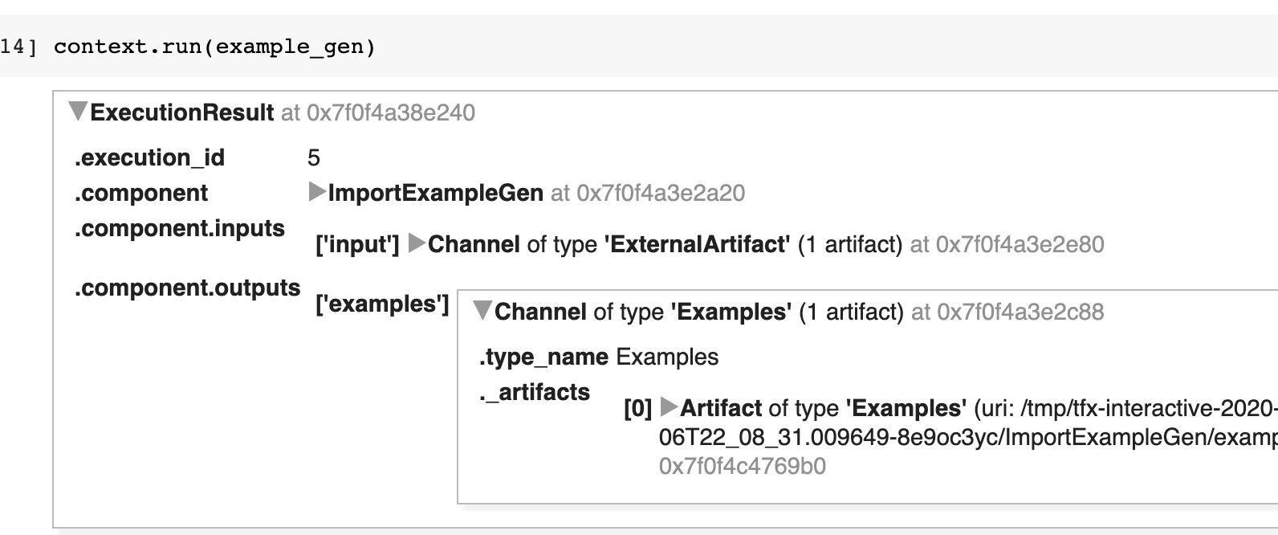
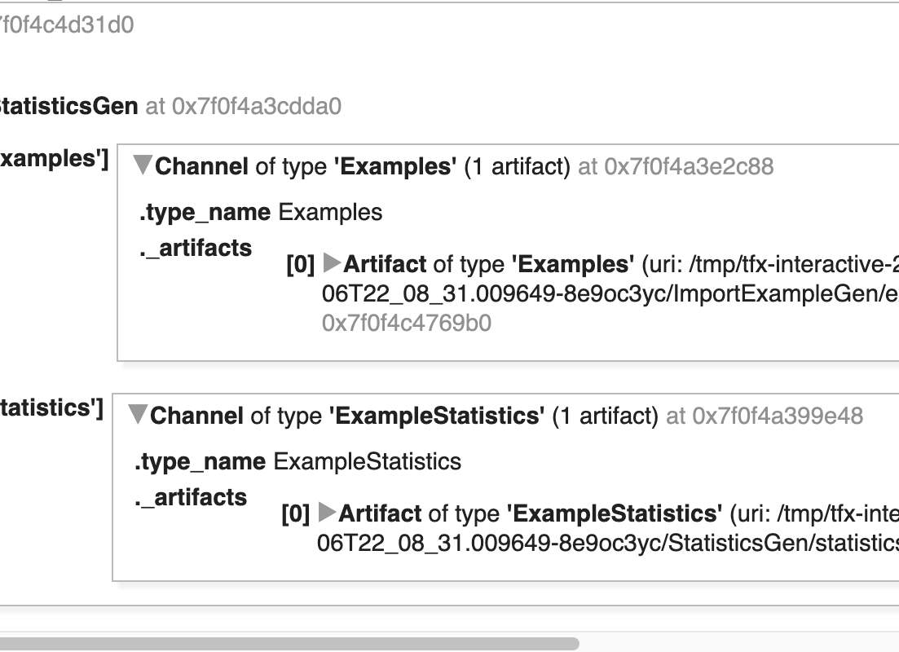
TensorFlow Extended (TFX)

Slide 18
Anomaly Detection Web App. Integration
Python Flask- Backend
WebApp-Client
Read Input Image
Angular
POST api/detectAnomaly
Preprocess Image
Run Inference
NodeJS
Compute Anomaly Score
Return Result

Slide 19
Results Summary
We learnt how GAN can be applied to anomaly detection
We trained two GANs end to end with mura dataset
We compared the results of the two GANs
Anomaly GAN performance is better compared to AlphaGAN

Slide 20
Delta
Training f-AnoGAN with Mura dataset
Metrics comparison of AlphaGAN and f-AnoGAN on X-ray images
TFX

Slide 21

Demo

Slide 22
Reference
F-AnoGAN - https://arxiv.org/pdf/1703.05921v1.pdf
AlphaGAN - https://arxiv.org/pdf/1807.10088.pdf

Slide 23
Thank you

